Slide 1
Pattern Recognition
Feature selection and data analysis with different ML techniques

Slide 2
Data Wrangling
Radiomics Dataset:
114 patients
114 features each
More than one image per patient
Removing "info" features
Filling null values
Dropping patients with #features ≠ 114
Features and Labels arrays:
Counting number of images per patient
Division CT – PET
"Recurrence" Labels (0 or 1)

Slide 3
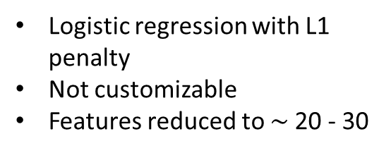
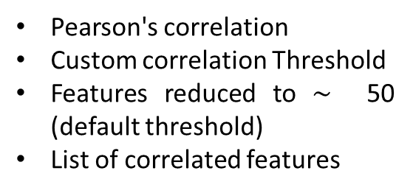
Feature Selection
Correlation Matrix
Lasso Regression
Random Forest
Pearson's correlation
Custom correlation Threshold
Features reduced to $\sim$ 50 (default threshold)
List of correlated features
Logistic regression with L1 penalty
Not customizable
Features reduced to $\sim$20 - 30
Relative feature importance
User chooses the number of features
Slightly customizable
Indexes of important features

Slide 4
Model Selection
Logistic Regression
Support Vector Machine
Random Forest
Bag Classifier
Four different ML models were used:
All the models were trained using the 70% of the data and evaluated on the remaining 30%.
The metrics used for evaluation were Precision and Recall.
Random Forest obtained the best values, with Precision and Recall up to approximately 0.75 and 0.80 respectively.
For this reason, Random Forest was chosen as the base model and a Grid Search was performed in order to find the best parameters for the estimator.

Slide 5
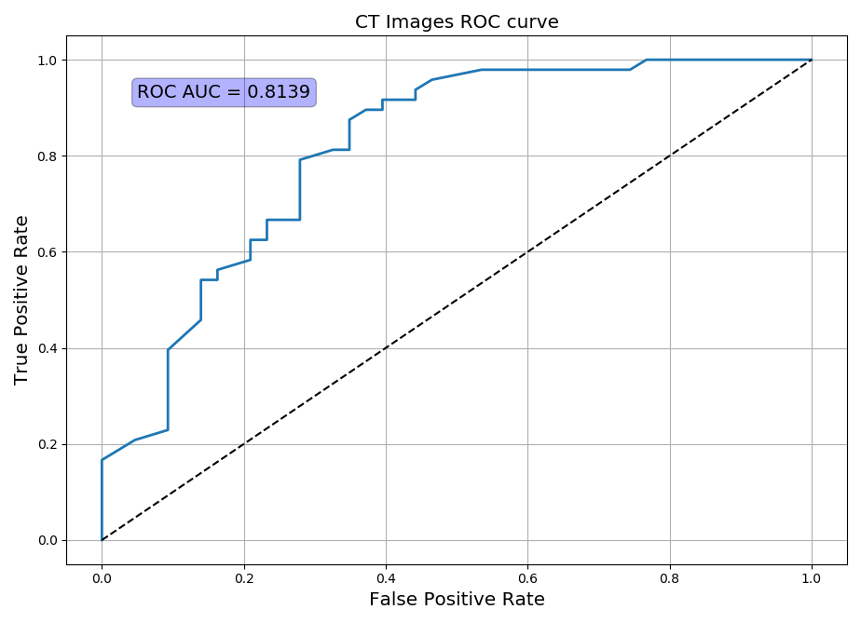
Results CT
The Random Forest Classifier achieves, for CT images, a Precision of 0.734 and a Recall of 0.792, with an F1 Score of 0.776.
In the image on the left we can see the ROC curve of the Random Forest classifier (in blue) for the CT images dataset. The dotted line represents the curve of a random classifier.
The Area Under the Curve (AUC) is 0.814.

Slide 6
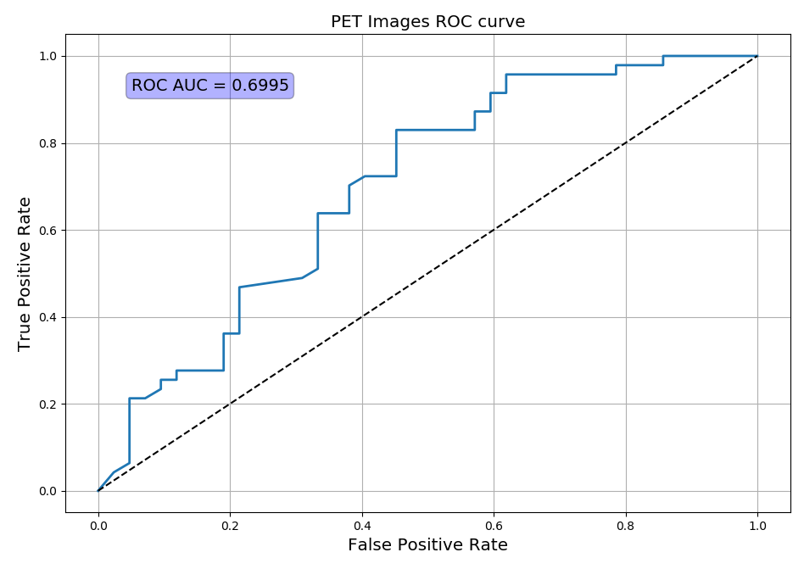
Results PET
The results for PET images are not as good as the CT ones, although the same classifier, with the same parameters, was used.
For PET images, the Random Forest classifier reaches a Precision of 0.667, with a Recall of 0.723. The F1 Score is 0.694.
Again, the image on the left shows the ROC curve of the classifier (in blue).
This time the AUC is about 0.7.

Slide 7
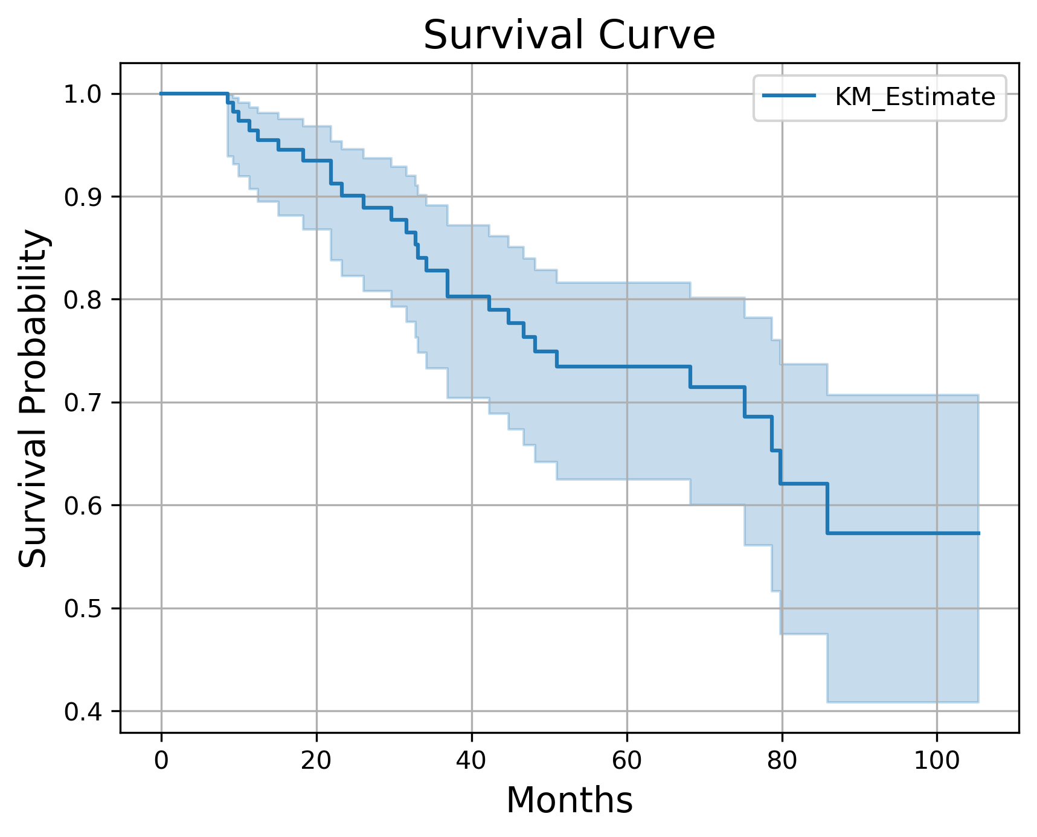
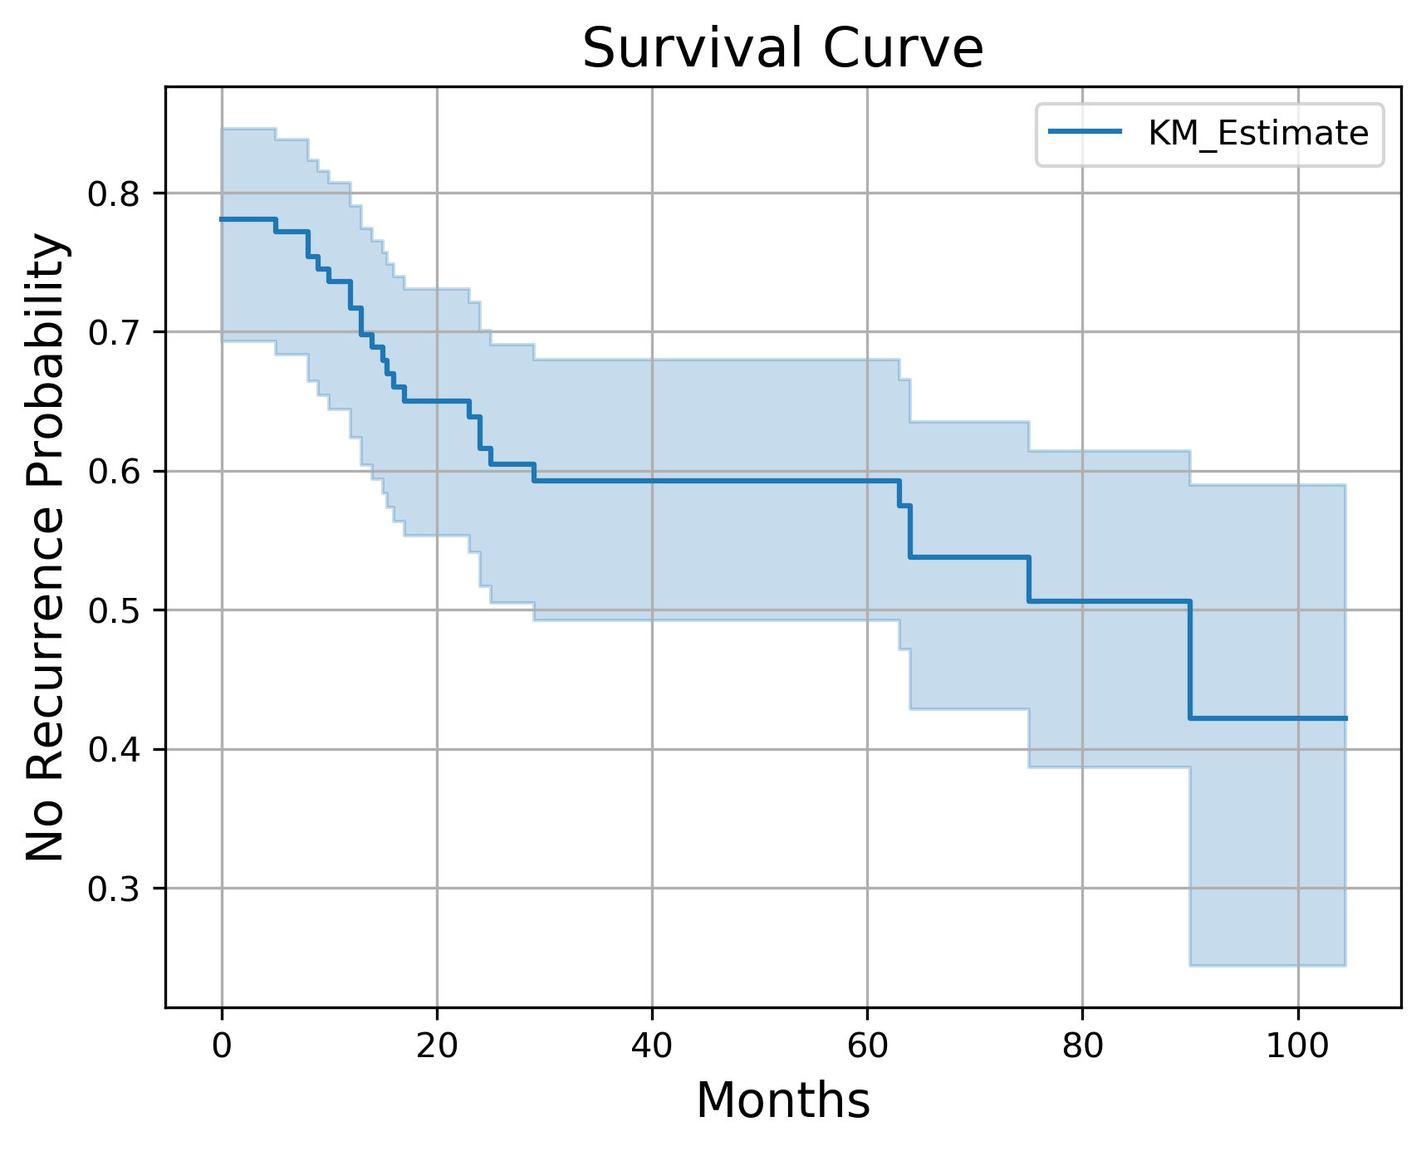
Survival Curves

Slide 8
Cox's proportional hazard model
To fit Cox's model to the data, features from CT images were used, because they gave the best results with the Random Forest Classifier (RFC). Features were reduced to 15 using the Random Forest.
Problem: Each patient has a different number of associated CT images (from 1 to 15). All the images were used to train the RFC, but only one image per patient can be used for the survival curve, otherwise patients with more images would correspond to more occurrences.
My approach: the average value over all the images of a patient was computed for every feature.
In the end, the concordance index was used as a measure of the goodness of the fit; the value obtained is 0.74.

Slide 9
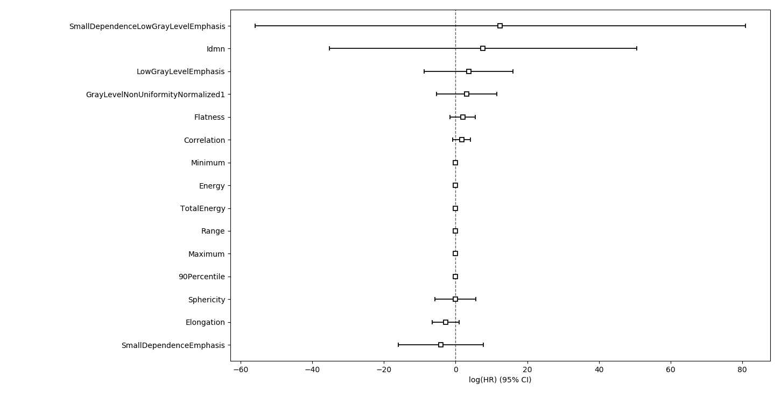
Coefficients of Cox’s proportional hazard model

Slide 11
